Slide 1
Neural Networks and Deep Learning
Course No : CE 889
Exploring MLP Performance and Kaggle Competition Insight
Presentor : Samia Rahman Misty
Registration No : 2400570

Slide 2

Multi-Layer Perceptron Performance for Rocket Landing Game

Slide 3
Data Processing Techniques
The dataset consisted of 733,582 rows with 4 columns: the first two columns served as inputs, and the last two as outputs.
Null values were removed to maintain data integrity.
Outliers were identified and handled, enhancing data reliability and robustness.
Normalization was applied post-outlier removal to ensure consistent scaling.
The dataset was split into 70% training and 30% testing sets after normalization.
Consistent scaling across training and testing was maintained for accurate predictions.
Data shuffling was attempted but negatively impacted results, so it was excluded.

Slide 4
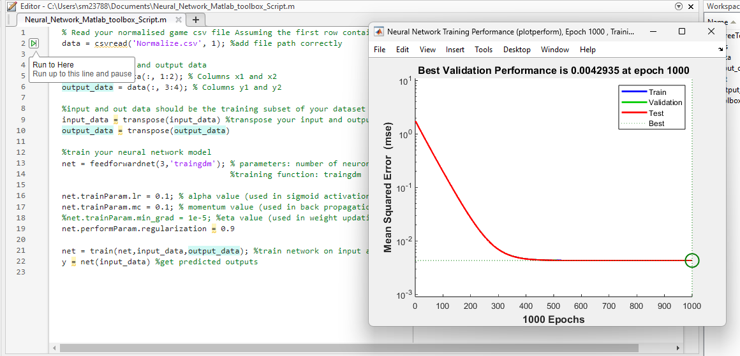
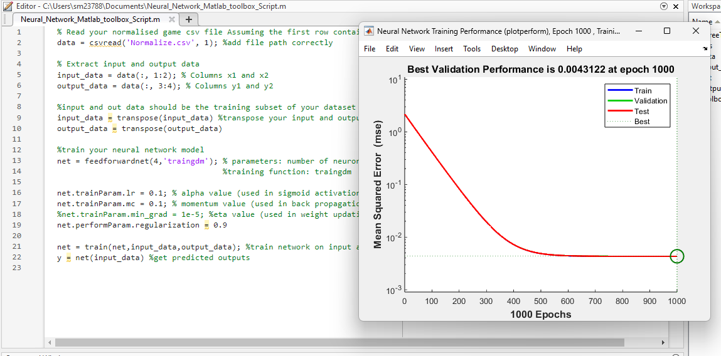
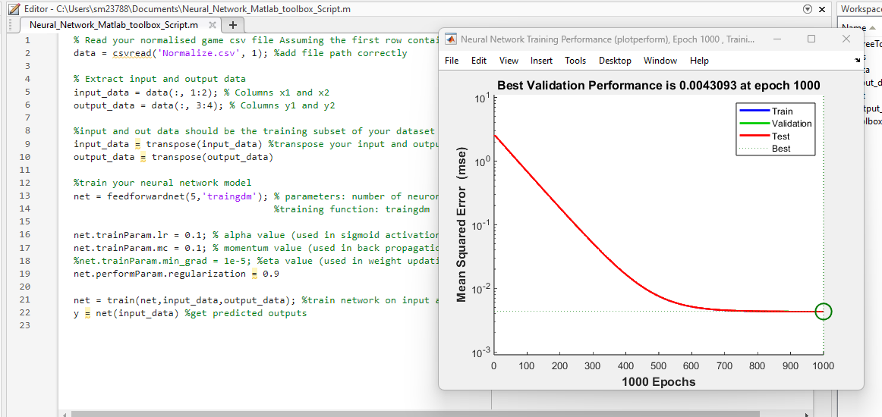
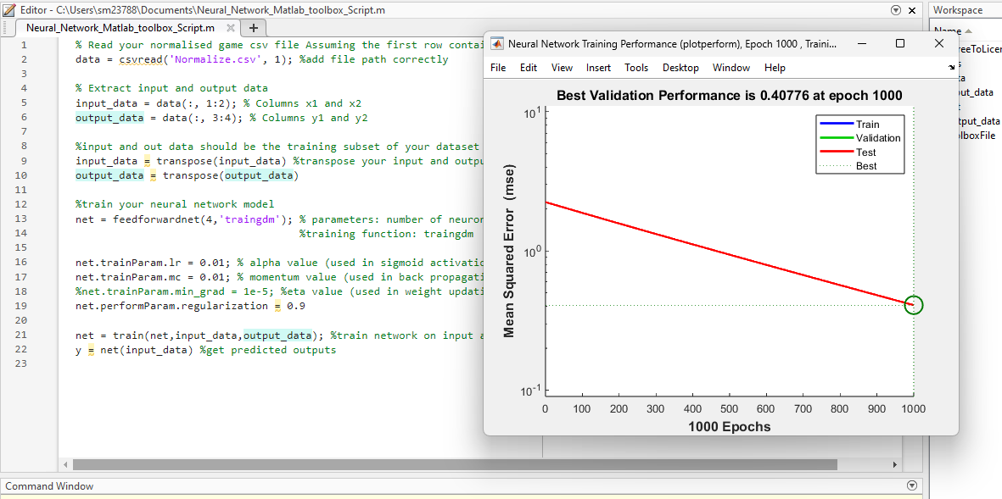
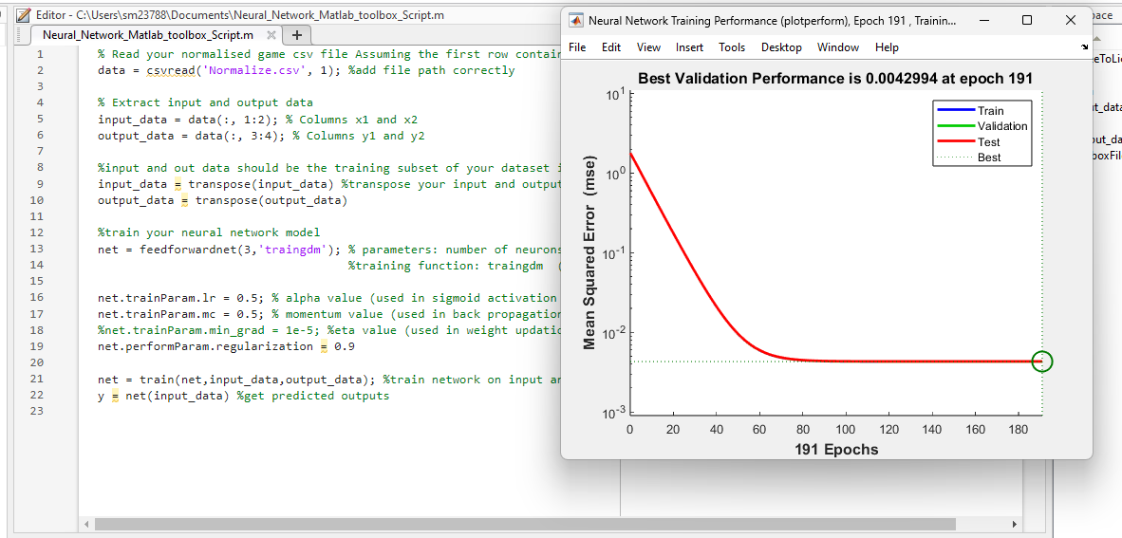
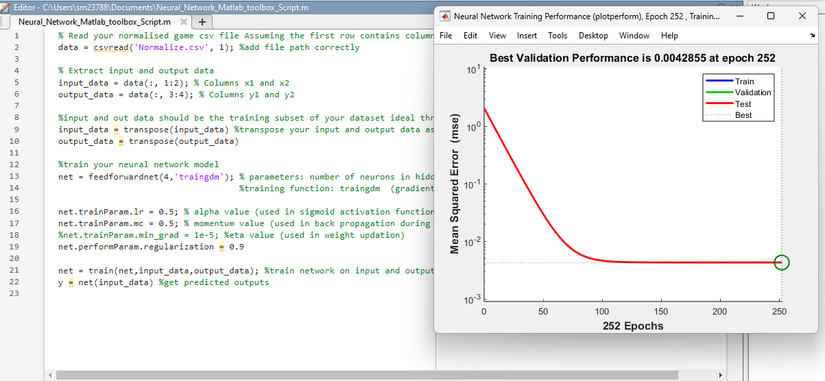
Parameter Justification

Slide 5
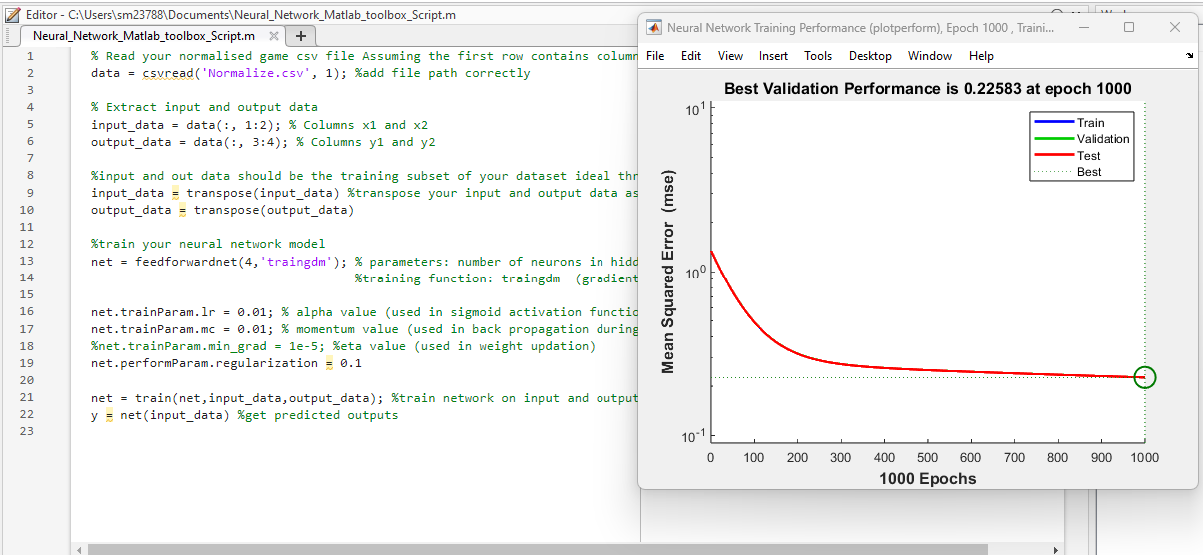
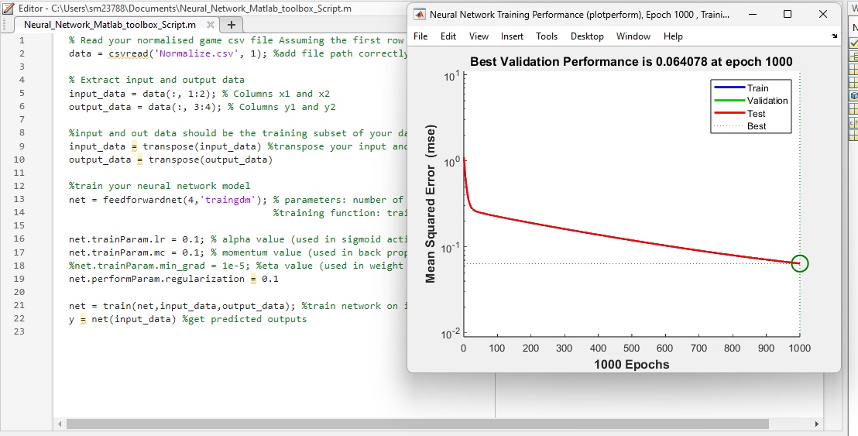
Parameter Justification
Tested 8 combinations of hyperparameters to find the optimal configuration.
Learning rate: 0.1, momentum: 0.1, and lambda: 0.9 with 3 neurons achieved the lowest RMSE value of 0.0042935.
Despite the lowest RMSE, the model with 3 neurons did not perform well in the game.
The same hyperparameter values with 5 neurons achieved better RMSE but also failed to deliver better in-game performance.
The best in-game performance was achieved with 4 neurons using the same hyperparameter values.

Slide 6
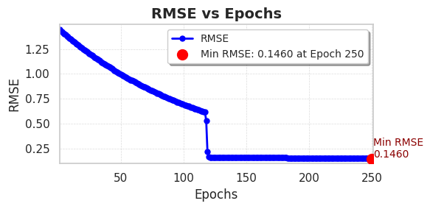
Stopping Criteria & RMSE Calculation
Initial training was done for 250 epochs, but RMSE plateaued after 124 epochs, suggesting early stopping at epoch 124 for optimal performance.
Achieved an RMSE of 0.146029 on the training dataset and 0.146012 on the test dataset, indicating effective learning and consistency between both datasets.

Slide 7
Game Performance Insights
The trained model successfully landed the rocket in several scenarios but missed some targets.
The rocket landed when the lander was on the right, left, or in the middle, but failed when it was near the middle.
The issue was identified as a lack of data in this specific scenario during data collection, affecting the model’s ability to handle it.
Initially, the game performance was suboptimal, but after swapping the X and Y values while returning to game, the game performance improved.

Slide 8
Deep Learning: Kaggle Competition
Rossmann Store Sales :
Rossmann is challenging you to predict 6 weeks of daily sales for 1,115 stores in Germany, considering factors like promotions, holidays, and seasonality. Accurate forecasts will help store managers optimize staff schedules and enhance productivity.
Dataset :
https://www.kaggle.com/competitions/rossmann-store-sales/overview

Slide 9
Pre-processing
Dataset Merging
Merged the train and test datasets with the store dataset.
Then, merged the sample dataset with the test dataset to get the predicted sales values.
2. Feature Engineering
Handling 'StateHoliday' Column: Replaced '0' with 0 in the StateHoliday column for both training and test datasets to maintain consistency.
Removing Irrelevant Rows: Filtered out rows where the store is closed (Open == 0), as these rows do not contribute to the sales analysis.
Converted the Date column to datetime format for easier manipulation and analysis.
Extracted the year, month, and day from the Date column to create new columns: Year, Month, and Day. These are helpful for time-based analysis.

Slide 10
Pre-processing
Grouped the data by Year and Month and calculated the total sales for each month to identify trends.
Applied the same date conversion and feature extraction (year, month, day) to the test dataset for consistency.
3. Train Test Split
Creating Training and Validation Datasets:
Training Dataset: Filtered data for years <= 2014 to train the model on historical data.
Validation Dataset: Filtered data for the year 2015 to evaluate model performance on unseen data.

Slide 11
Pre-processing
Training Features and Targets:
Created separate copies of input features (train_features) and target (train_targets) from the training dataset.
Validation Features and Targets:
Created separate copies of input features (validation_features) and target (validation_targets) from the validation dataset.
Test Features:
Extracted input features from the test dataset (test_features) for prediction.
Numerical Columns:
Identified columns containing numerical data for potential scaling or normalization.
Categorical Columns:
Identified columns requiring encoding or other preprocessing steps.

Slide 12
Pre-processing
4. Encoding
Applied one-hot encoding to categorical columns in the dataset.
Each category is transformed into a separate binary column, enabling the model to handle categorical data effectively.
5. Scaling
Used MinMaxScaler to scale numerical features to a range of [0, 1].
This helps to standardize the data, making it more suitable for model training.

Slide 13
Long Short-Term Memory (LSTM)
Data Preprocessing:
Reshape features to 3D format: [samples, timesteps, features]
Run the model with 10 Epoch
LSTM Architecture:
Layer 1: LSTM (64 units), activation='relu', input_shape=input_shape.
Dense Layer 1: 32 units, activation='relu'.
Output Layer: 1 unit for regression.
Compilation:
Optimizer: Adam
Loss Function: MSE (Mean Squared Error)

Slide 14
Results and Observations
Approach 1:
Using Time-Series Sequences
Sequence length: 30
Achieved RMSE: 587.822
Kaggle Scores:
Private: 0.91120
Public: 0.92310
Approach 2:
Without Using Time-Series Sequences
Trained the model directly without converting data into sequences.
Achieved RMSE: 2595.42
Kaggle Scores:
Private: 0.34994
Public: 0.35775

Slide 15
Thank You
Questions are Welcome !

